Slide 1

Seasonal Agriculture Performance Analysis
Name: Rakshitha B N
College: BMS Institute of Technology and Management (BMSIT&M), Bengaluru
AICTE STU ID : STU6a60e8644cc731784735844

Slide 2

PROBLEM STATEMENT
(Agricultural activities are influenced by seasonal variations in environmental conditions, farming practices, resource availability and market conditions. As a result, agricultural performance may differ from one season to another. However, raw agricultural data does not clearly explain how agricultural performance changes across seasons or what patterns can be observed in different seasonal conditions. The problem is to analyze the given agricultural dataset and investigate seasonal differences in agricultural performance by identifying meaningful patterns, trends, relationships and variations within the available data.

Slide 3
Project Description This project analyzes a seasonal agriculture performance dataset covering 4,000 farm records across 8 Indian states, 10 districts, 8 crops and 3 cropping seasons (Kharif, Rabi, Zaid.
The dataset captures environmental conditions (rainfall, temperature, humidity, soil health), input usage (fertilizer, pesticide, irrigation, water), and economic outcomes (cost, revenue, profit) for every farm.
The workflow follows a standard data analytics pipeline: data cleaning (handling missing values in rainfall, soil moisture and yield), exploratory analysis, seasonal comparison using groupby/pivot analysis and ANOVA tests, correlation analysis, and visualization using Python (Pandas, NumPy, Matplotlib, Seaborn, SciPy).
The goal is to uncover how season, crop choice and irrigation method drive yield, profitability and resource efficiency, and to translate these findings into evidence-based recommendations for seasonal agricultural planning.

Slide 4

WHO ARE THE END USERS?
Farmers & farmer cooperatives – to choose season-appropriate crops and irrigation methods
State Agriculture Departments – for evidence-based seasonal planning and policy design
Agri-input & agribusiness companies – to time fertilizer, seed and irrigation-equipment supply
Banks, NBFCs & crop insurers – to assess seasonal risk and set credit/insurance terms
Agricultural researchers & extension officers – to study seasonal yield and resource patterns
Agri-tech and market intelligence platforms – to power advisory and price-forecasting tools

Slide 5

Technology Used
Python 3 – core analysis language
Pandas & NumPy – data cleaning, wrangling and aggregation
Matplotlib & Seaborn – statistical visualization (bar, box, heatmap, stacked charts)
SciPy (stats) – ANOVA significance testing across seasons
VS Code – documenting the full analysis workflow
Microsoft PowerPoint – project reporting and presentation
GitHub – version control and project submission

Slide 6
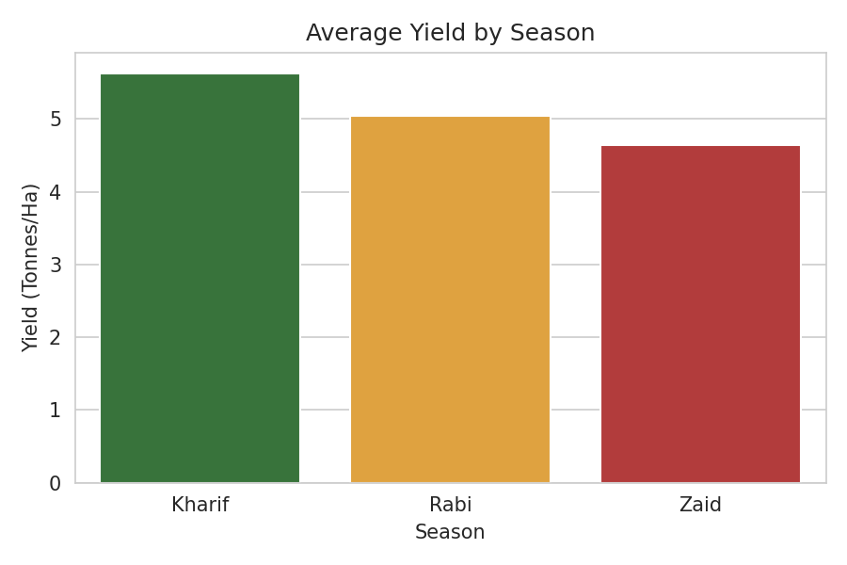
RESULTS
Yield by Season
Kharif shows the highest average yield (5.63 t/ha); ANOVA p=0.21 (not significant)

Slide 7
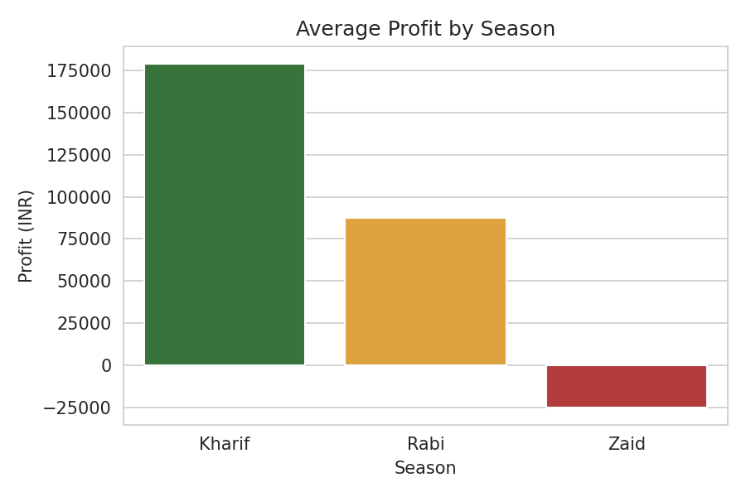
RESULTS
Profit by Season
Kharif is most profitable (₹1.79L avg); Zaid runs a net loss (ANOVA p<0.001, highly significant)

Slide 8
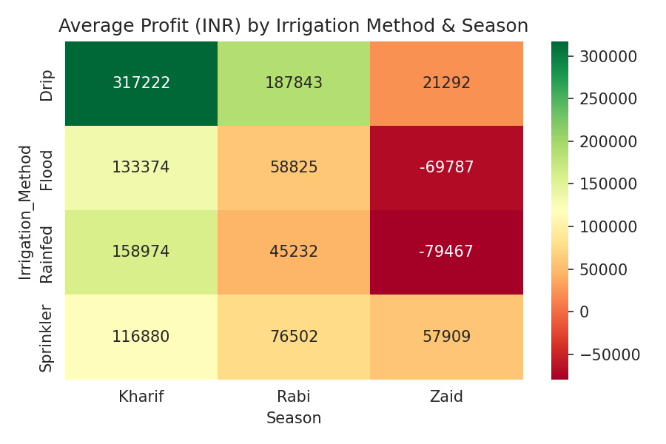
RESULTS
Profit: Irrigation x Season
Drip irrigation gives the highest average profit in every single season

Slide 9
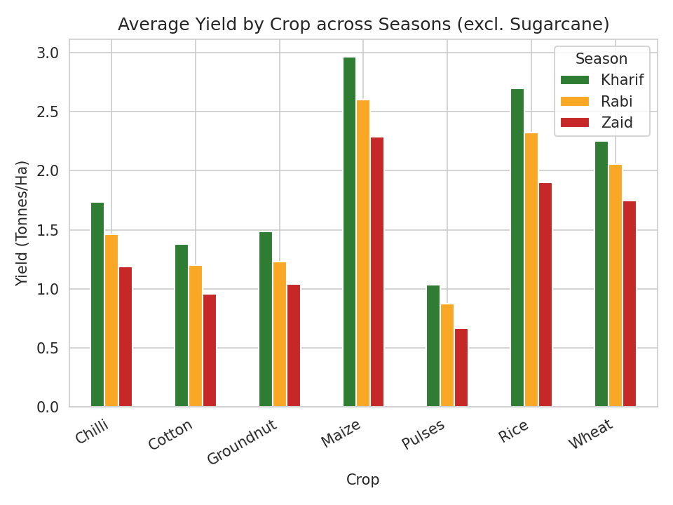
RESULTS
Crop Yield Across Seasons
Every crop, incl. Sugarcane (~53 t/ha), peaks in Kharif and dips in Zaid

Slide 10
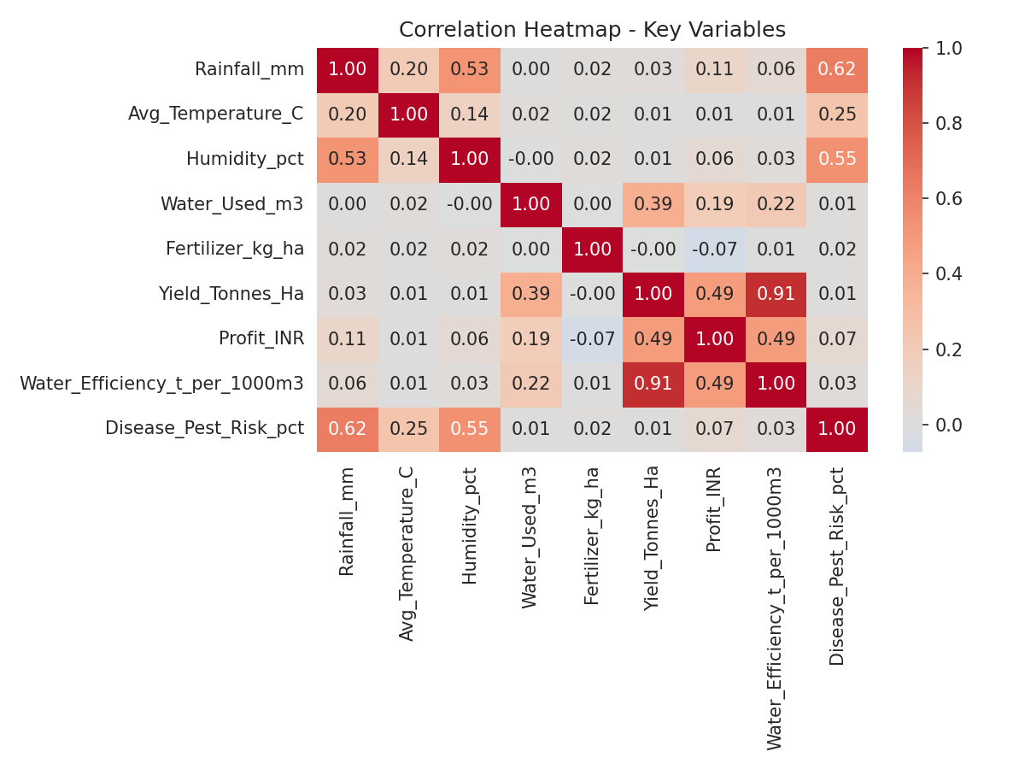
RESULTS
Correlation Heatmap
Yield correlates most with Water_Used (r=0.39); Profit is unrelated to fertilizer/pesticide spend

Slide 11
Future scope
Extend the analysis with district- and farm-level weather/soil data (e.g. real IMD rainfall records) for higher-resolution seasonal insights
Build a predictive model (regression / ML) to forecast yield and profit from season, crop and input variables
Incorporate multi-year data to study year-on-year seasonal trends rather than a single-season snapshot
Develop an interactive dashboard (e.g. Power BI / Streamlit) for farmers and officials to explore seasonal performance by state and crop
Add crop-recommendation logic that suggests the most profitable crop-season-irrigation combination for a given region
Integrate market price forecasting to link seasonal production patterns with expected revenue

Slide 12
GitHub Link
https://github.com/Rakshitha-52/seasonal_crop_analysis.git

Slide 13
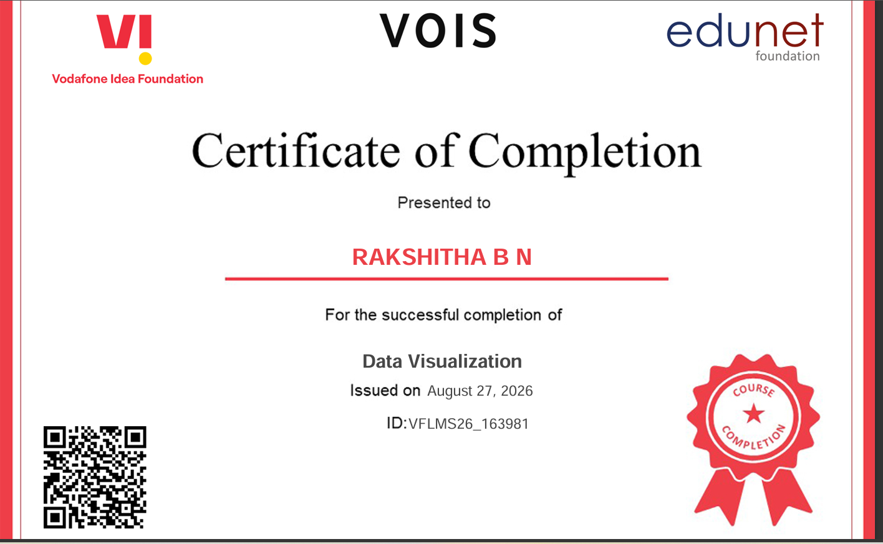
VOIS Course completion certificate - Course name- Data Visualization

Slide 14
Thank you
.
.

